Slide 1
Continuous Data
Number of possible values is very large
strictly speaking uncountably infinite!
Measurements:
interval, eg temperature
ratio, eg money
Large counts:
treated as being effectively continuous
Eg number of red blood cells per 100ml of blood

Slide 2
Continuous Data
Summaries :
grouped frequency tables
summary statistics eg averages
Displays
dotplots, stem-and-leaf diagrams, histograms, box and whisker plots (a.k.a. boxplots)
More on these in the next couple of practicals.

Slide 4
What are we looking for?
Location – What is a “representative” value? the “centre” of the data?
Spread – How variable is the data? What range or dispersion?
Shape – Are there unusual or outlying values? Mistakes? Or crucial evidence?
Is there more than one group? Bimodal? Multimodal?
Symmetric or skewed? To the right (positively skewed)? Or the left (negatively skewed)?
Important ranges – eg what proportion lie inside target specifications?

Slide 5
Comparisons
Different subgroups eg
male versus female
different age groups
different income groups
etc

Slide 6
Some Pitfalls
Summary statistics
rarely make sense for qualitative, discrete data
Barcharts and tables
do not work well when number of possible responses is large

Slide 7
Summary Statistics -Location
The Median, m
Put data in increasing order
50% of data lie below m, 50% above
If n odd : m = middle value
If n even : m = average of middle two

Slide 8
The Mean,

Slide 9
The Mode
The most frequently observed value
Possibly of interest for discrete data
For measurement data, rarely of interest

Slide 10
Mean versus Median
Mean
makes more efficient use of all the data
but is strongly affected by outliers
Median
unaffected by outliers - outlier resistant

Slide 11
Measures of Spread
The Range
Maximum – Minimum
Inter Quartile Range, IQR = Q₃ - Q₁
Q₁ = lower quartile : 25% of data below, 75% above
Q₃ = upper quartile : 75% of data below, 25% above
totally unaffected by outliers
Range and IQR therefore complement each other

Slide 12
Standard Deviation s or SD(x)
SD(x) = √s² where
which is called the sample variance
Divide by (n-1) rather than n to get an unbiased estimator of the variance (called Bessel’s correction - we’ll prove this later in the module).
Dividing by n tends to give too low a value

Slide 13
Descriptive Statistics: Time on Social Networking Sites
Variable | Gender | N | Mean | StDev | Min. | Q1 | Median | Q3 | Max.
Time (Hrs/day) | Men | 127 | 2.102 | 1.975 | 0 | 1 | 1 | 2 | 10
 | Women | 112 | 2.429 | 1.897 | 0 | 1 | 2 | 3 | 12

Slide 14
Accuracy of results
Usual advice for final reports etc
‘Two variable-digit rule’
Round the average to 2 (variable) digits
Quote the SD to one extra place
BUT in tests or exams (or mid-calculation)
state the answer on the calculator using several more significant digits than strictly necessary
then round to give the final answer

Slide 15
Box and Whisker Plot
The 5 Number Summary
The median, represented by the line inside the box.
The upper and lower quartiles, represented by the upper and lower sides of the box.
The maximum and minimum, represented by the extreme ends of the 'whiskers'
provided these are no more than 1.5 × IQR.
Outliers, any data points beyond 1.5 × IQR, represented as *, ie by an asterix.

Slide 18
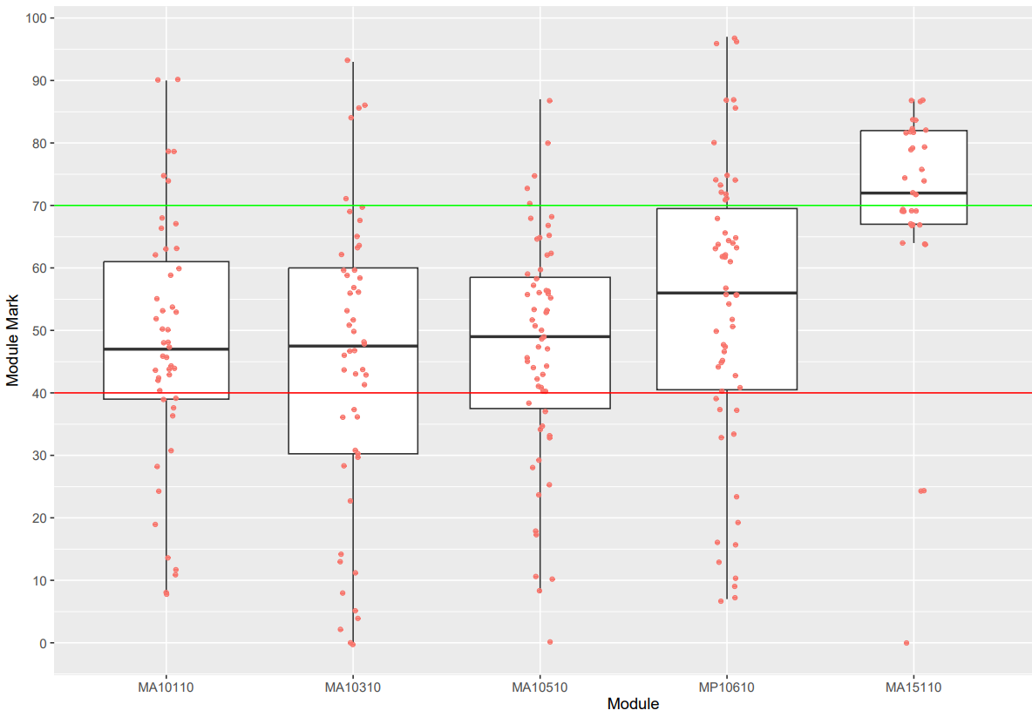
Module Marks
Year One, Semester One (not your yeargroup!)

